Slide 1



Slide 2
Physically Based Lighting in
Call of Duty: Black Ops
Dimitar Lazarov, Lead Graphics Engineer, Treyarch

Slide 3
Agenda
Physically based lighting and shading
in the context of evolving Call of Duty’s graphics
and what lessons we learned
Notes:
To explain why Physically based lighting/shading made sense for Black Ops we have to start with some background on Call of Duty’s rendering engine architecture.

Slide 4
Performance
Shapes all engine decisions and direction
Built on two principles
Constraints
Specialization
Notes:
For Call of Duty, everything starts and ends with performance (frame rate of 60 fps).
Constraints – carefully selected, simplifies difficult problems, saves implementation time
Specialization – special case processing and avoid abstraction penalties, push the constraints to max
Lighting and shading is just one example of those principles, which will hopefully transpire in the following slides.

Slide 5
Constrained rendering choices
Forward rendering, 2x MSAA
Single pass lighting
All material blending inside the shader
Almost all transparencies either alpha tested (foliage, fences) or blended but with simple shading (pre-lit particles)
Notes:
Deferred lighting not suitable for 60fps.
Too much constant overhead, extra passes or fat G-Buffer, doesn’t handle MSAA, doesn’t handle transparency.
Blending is still just too expensive.

Slide 6
Forward rendering
Forward rendering has traditional issues when it comes to lighting:
Exponential shader complexity
Multi-pass
Wasteful on large meshes
Unless:
Notes:
Even forward rendering does not guarantee running well at 60 fps.

Slide 7
Lighting constraints
One primary light per surface!
Notes:
Surface – a piece of geometry associated with one material (and one light) = one draw call
World static geometry is chopped up + carefully authored lights.
Static/dynamic objects pick one based on light origin.

Slide 8
Lighting constraints
However:
unlimited secondary (baked) lights
small number of effect lights per scene:
4 diffuse-only omni lights (gun flashes etc)
1 spot light (flashlight)
Notes:
Effect lights used to be done via additive passes, but for Black Ops we switched to a single pass (via shader permutations).

Slide 9
Baked lighting
Performed offline in a custom global illumination (raytracing) tool, stored in three components:
Lightmaps
Lightgrid
Environment Probes
Notes:
We rely heavily on baking. This is one of the components that guarantees constant performance.
Lightmaps – used on world geometry (BSP)
Lightgrid – used for static and dynamic objects, at sparse but fixed grid locations, stores also primary light choice per grid
Environment probes – applied to all geometry, art authored locations

Slide 10
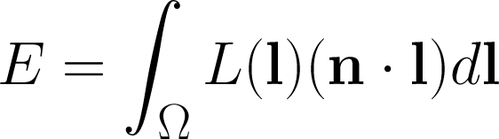
Radiance vs. irradiance
Radiance (L)
Irradiance (E)
Notes:
To help understand the baked lighting, I’ll briefly explain the difference between irradiance and radiance, two different measures of light intensity and color. Irradiance is the overall amount of light coming into a surface point from all directions. It is related to diffuse shading and (for a given point) depends on the surface normal n. Radiance is the amount of light in a single ray. The two are related via an integral - irradiance equals the integral (over the hemisphere incoming light directions l) of radiance weighted by n dot l (the “dl” at the end is just part of the integral). The dot product doesn’t need to be clamped here since in the hemisphere it is always positive, but when used in shaders it typically needs to be clamped.

Slide 11
Run-time lighting
All Primary lighting is computed in the shader
A run-time shadowmap per primary overrides the baked shadow in a radius around the camera
As a result:
Primary can change color and intensity, move and rotate to a small extent and still look correct
Static and dynamic shadows integrate well together
Notes:
The sun always has 2 cascaded shadowmaps.
Spot/omni get 1 shadowmap, up to 4 shadowmaps in view.

Slide 12
Run-time lighting: diffuse
Primary Diffuse
Classic Lambert term
Modulated by the shadow and the diffuse albedo
Secondary Diffuse
Reconstructed from lightmap/lightgrid secondary irradiance with per-pixel normal, modulated by the diffuse albedo
Notes:
The diffuse portion isn’t anything new or special, we won’t go into detail.

Slide 13
Run-time lighting: specular
Primary Specular
Microfacet BRDF
Modulated by the shadow and the “diffuse” cosine factor
Secondary Specular
Reconstructed from environment probe with per-pixel normal and Fresnel term, also tied to secondary irradiance
Based on same BRDF parameters as primary specular
Notes:
Microfacet BRDF and environment normalization new for Call of Duty: Black Ops. Most of the improvements focused on the specular shading.
Modulating a specular BRDF by the “diffuse” cosine is the right thing to do – this factor is actually not part of the diffuse BRDF but of the equation the BRDF is plugged into.

Slide 14
Why Physically-Based
Crafting Physically Motivated Shading Models for Game Development (SIGGRAPH 2010):
Easier to achieve photo/hyper realism
Consistent look under different lighting conditions
Just works - less tweaking and “fudge factors”
Simpler material interface for artists
Easier to troubleshoot and extend

Slide 15
Why Physically-Based continued
Call of Duty: Black Ops objectives:
Maximize the value of the one primary light
Improve realism, lighting consistency (move to linear/HDR lighting, improve specular lighting)
Simplify authoring (remove per material tweaks for Fresnel, Environment map etc)
Notes:
Physically based lighting a good match to our objectives.

Slide 16
Some prerequisites
Gamma correct pipeline
Used gamma 2.0, mix of shader & GPU conversion
HDR lighting values
Limited range (0 to 4), stored in various forms
Exposure and tone-mapping
Art-driven, applied at the end of every shader
Filmic curve part of final color LUT
Notes:
Gamma:
Textures converted from sRGB to gamma 2.0 offline, would have been smart to not do it all.
HDR:
No clear good solution. Tons of “unsatisfactory” tradeoffs – filtering, range, size, speed.
FP16 is just not feasible at 60fps, barely so for 30fps.
Exposure:
Art-driven exposure has several advantages one of them is speed. No need to spend GPU cycles on finding the scene exposure.
Filmic curves are best done in HDR but due to performance constraints had to be done in LDR.

Slide 17
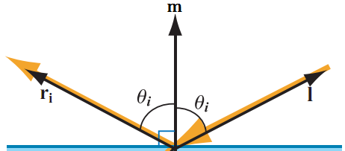
Microfacet theory
Theory for specular reflection; assumes surface made of microfacets – tiny mirrors that reflect incoming light in the mirror direction around the microfacet normal m
Notes:
Here l is the incoming light direction, m is the microfacet normal, and ri is the reflection of l about m – note that both angles are equal (standard mirror reflection).

Slide 18
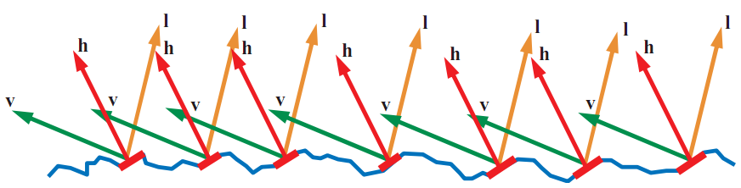
The half vector
For given l and v vectors, only microfacets which happen to have their surface normal m oriented exactly halfway between l and v (m = h) reflect any visible light
Image from “Real-Time Rendering, 3rd Edition”, A K Peters 2008
Notes:
This is the significance of the half vector (also called the half-angle vector) h.

Slide 19
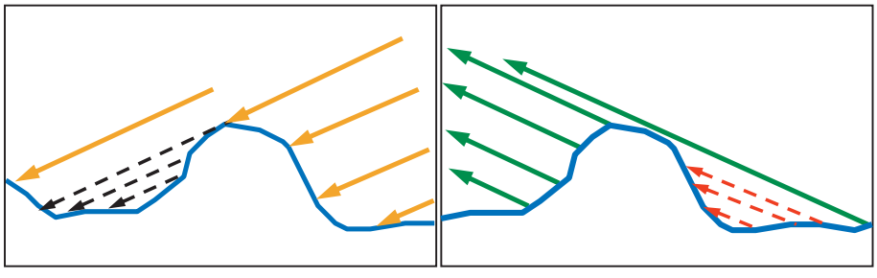
Shadowing and masking
Not all microfacets with m = h contribute; some blocked by other microfacets from l (shadowing) or v (masking)
shadowing
masking
Images from “Real-Time Rendering, 3rd Edition”, A K Peters 2008

Slide 20
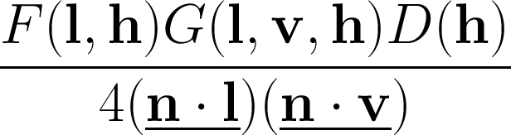
Microfacet BRDF
Notes:
The microfacet BRDF is derived directly from these assumptions.
Note that we are using an underbar as notation for “clamped to zero” – most dot products in this talk will be clamped.

Slide 21
Microfacet BRDF - D
Notes:
The microfacet normal distribution function D, evaluated for the half-angle direction h, basically is equal to the concentration of microfacets with m=h, or in other words those which are pointing just in the right direction to reflect l into v.
Another name for these is the active microfacets.

Slide 22
Microfacet BRDF - F
Notes:
The Fresnel reflectance function F, evaluated for the incoming light direction l and the microfacet normal direction is equal to the microfacet reflectance, or in other words the fraction of incoming light hitting each microfacet that is reflected back out again.

Slide 23
Microfacet BRDF - G
Notes:
The geometry function or shadowing / masking function G, evaluated for the given l and v vectors as well as the microfacet normal is equal to the fraction of active microfacets which are visible from both l and v.

Slide 24
Microfacet BRDF – the rest
Notes:
The rest of the microfacet BRDF are factors that fall out of the derivation. The ‘4’ is related to transforming from the space of half-angle directions to other spaces, and the two clamped dot products are foreshortening factors that relate to the way that the visible area of microfacets change in relation to their orientation.

Slide 25
Modular approach
Early experiments used Cook-Torrance
We then tried out different options to get a more realistic look and better performance
Since each part of the BRDF can be chosen separately, we tried out various “lego pieces”
Notes:
Our first tries at bringing physically-based shading to “Black Ops” used the Cook-Torrance BRDF, since a lot of references consider it to be a good example.
However, we wanted to look into BRDFs that were cheaper and possibly more realistic.
Since different parts of the BRDF such as the distribution function and shadowing-masking term can be chosen independently, we experimented with various choices for those parts instead of swapping out entire BRDFs.

Slide 26
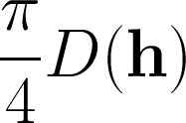
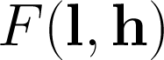
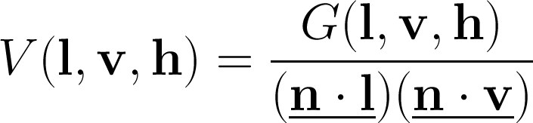
Shading with microfacet BRDF
Useful to factor into three components
Distribution function times constant:
Fresnel:
Visibility function:
Notes:
When implementing microfacet BRDFs in our shaders, we found it convenient to factor them into these three components and handle each one separately.
Regarding the “PI/4” constant multiplying the distribution function – the “1/4” comes from the microfacet BRDF in the previous slides, and the “PI” factor is something you need to multiply any BRDF by when using it with point or directional lights (an explanation of this can be found in the “Background: Physically-Based Shading” SIGGRAPH 2010 course notes).

Slide 27
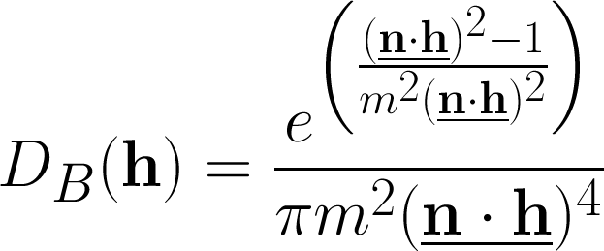
Distribution functions
Beckmann:
Read roughness m from an LDR texture (range 0 to 1)
Notes:
Since our physical shading experiments started with the Cook-Torrance BRDF, our first normal distribution function was the Beckmann function used by that BRDF.
We read the Beckmann roughness m directly from a texture, so we got a range of 0 to 1, which is a pretty good range, even though in theory m can go to infinity.
Divide by zero issues, need to add epsilon before clamping.

Slide 28
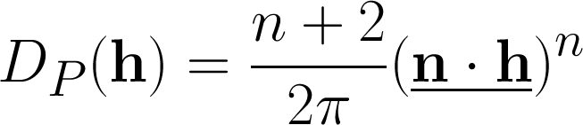
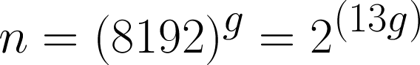
Distribution functions continued
Phong lobe NDF (Blinn-Phong):
Specular power n in the range (1, 8192)
Encode log in gloss map:
Notes:
To get a good range of specular powers with approximate perceptual uniformity across the range, we used a logarithmic encoding of the specular power in textures. The decoding in the shader used a multiply and an exp2, which wasn’t too bad (“g” is the gloss value read from the texture).
(n + 2) / (2 * PI) is the specular normalization term.
The PI will end up cancelling with the PI in the shading equation.

Slide 29
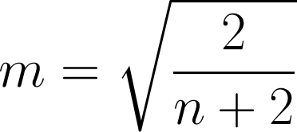
Distribution functions comparison
Beckmann, Phong NDFs very similar in our gloss range
Blinn-Phong is cheaper to evaluate and the gloss representation seems visually more intuitive
It is easy to switch between the two if needed:
Notes:
Additionally with Blinn-Phong when selecting mips in the environment map, the gloss representation gives natural results with a simple linear function.
On DX9 class GPUs:
Blinn-Phong: ~6 instructions
Beckmann: ~11 instructons

Slide 30
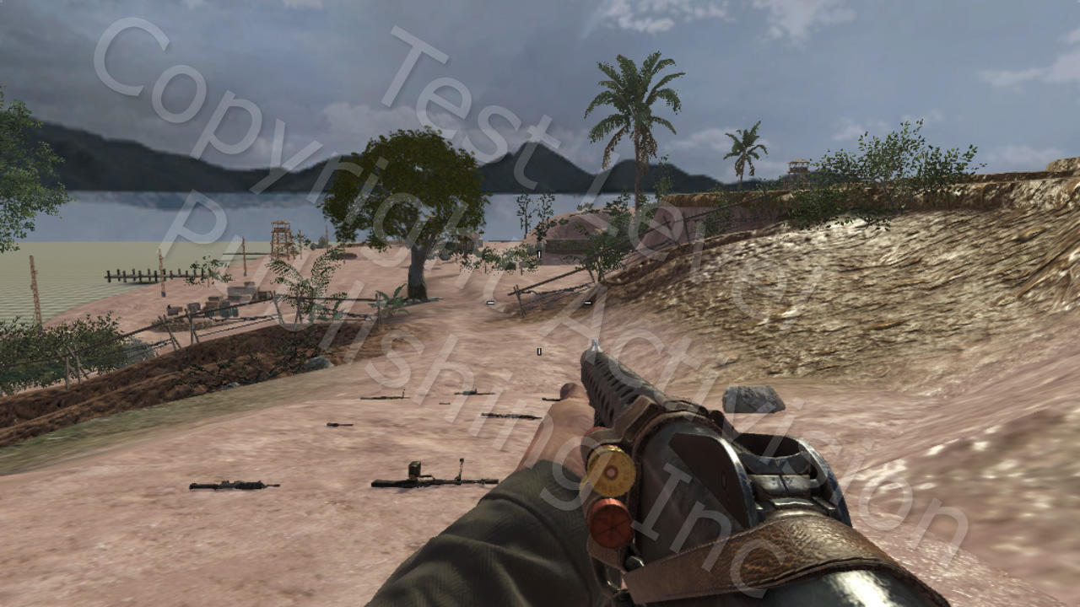
Beckmann Distribution function

Slide 31
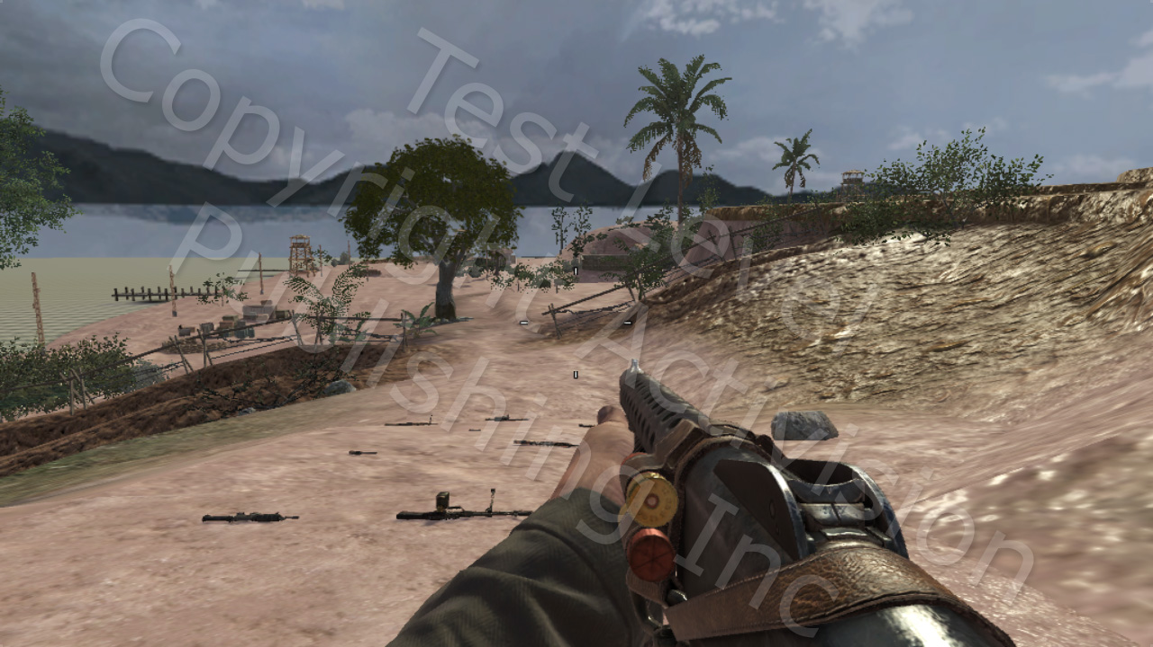
Blinn-Phong Distribution function

Slide 32
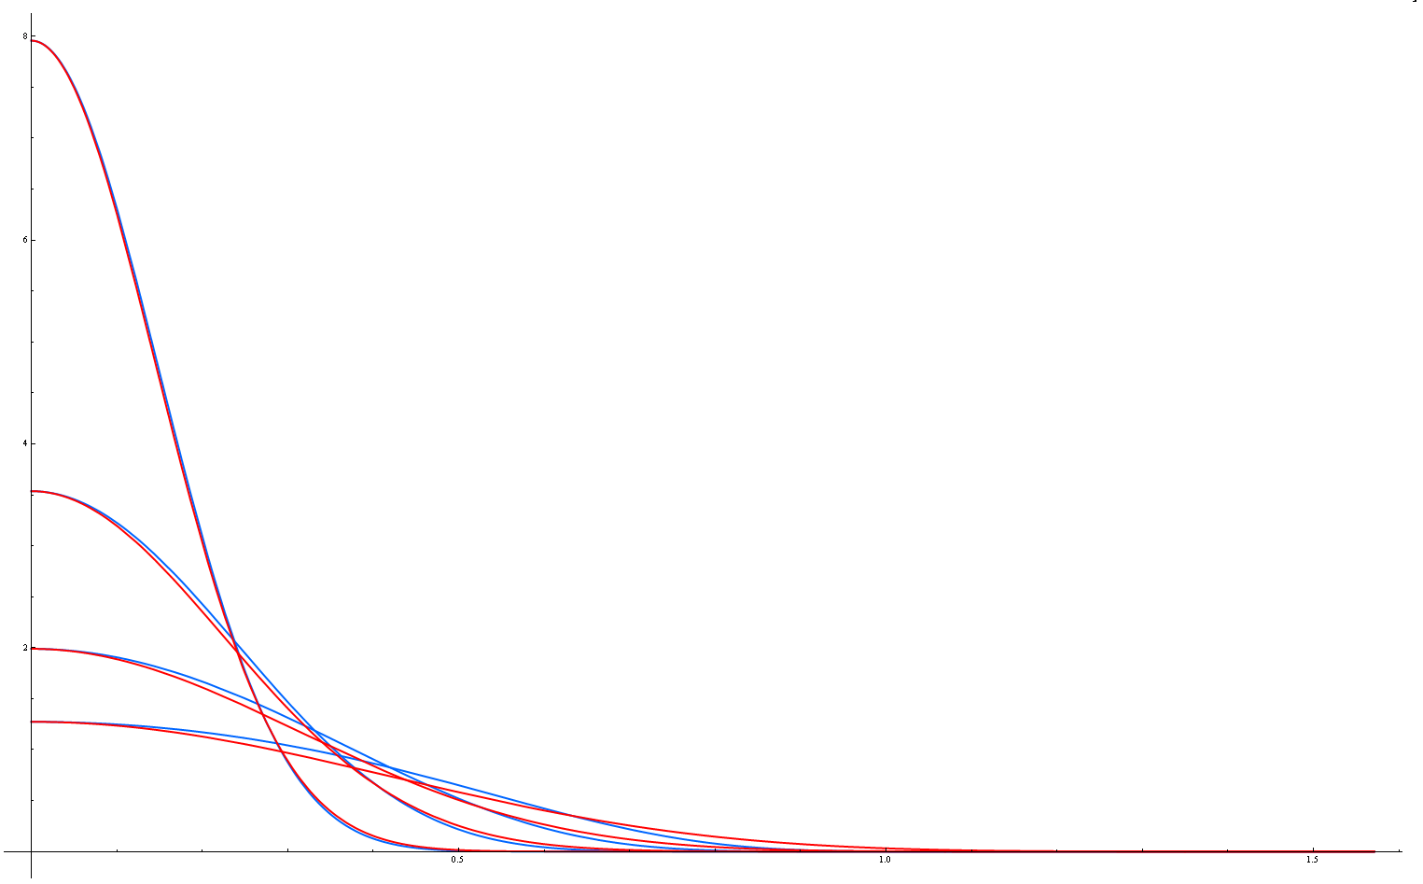
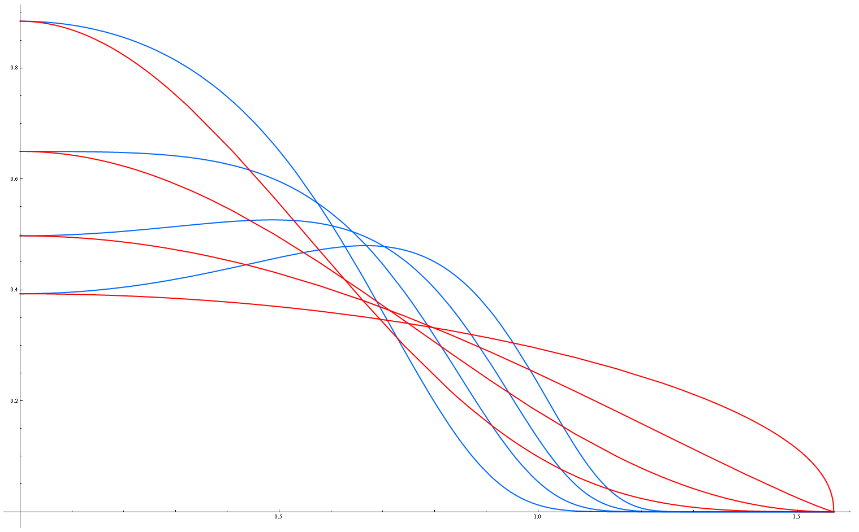
Distribution functions comparison
Blinn-Phong
Beckmann
m = 0.2, 0.3, 0.4, 0.5
m = 0.6, 0.7, 0.8, 0.9
Notes:
m grows from top to bottom.
m = 0.01 <-> n = 8192
m = 0.81 <-> n = 1
With low roughness (high specular power) the curves match really well.
With high roughness (low specular power) Beckman has a bit of a “hump” but the absolute intensity is very low and makes visually little difference.

Slide 33
Fresnel functions
Schlick’s approximation to Fresnel
Original (mirror reflection) definition: x= (n•l) or (n•v)
Microfacet form: x= (h•l) or (h•v) (no clamp needed)
Better not to have highlight Fresnel at all rather than use the “wrong” mirror form for highlights
Notes:
Note: here “c_spec” is the base specular color, or the reflectance when the light and view directions are the same as the normal.
Fresnel (and the Schlick approximation) is originally defined for mirror reflections, and uses the angle between the light (or view) direction and surface normal.
But for microfacet highlights, the surface normal is actually h (since that is the case for the active microfacets). Note that the angle between h and l (or v) can never be greater than 90 degrees so a clamp is not needed.
Using “x=(n dot v)” is OK for environment maps used for mirror reflections (not preflitered environment maps used for glossy reflections – I’ll talk more about that later). However it is a common mistake to use that for both environment maps and highlights.

Slide 34
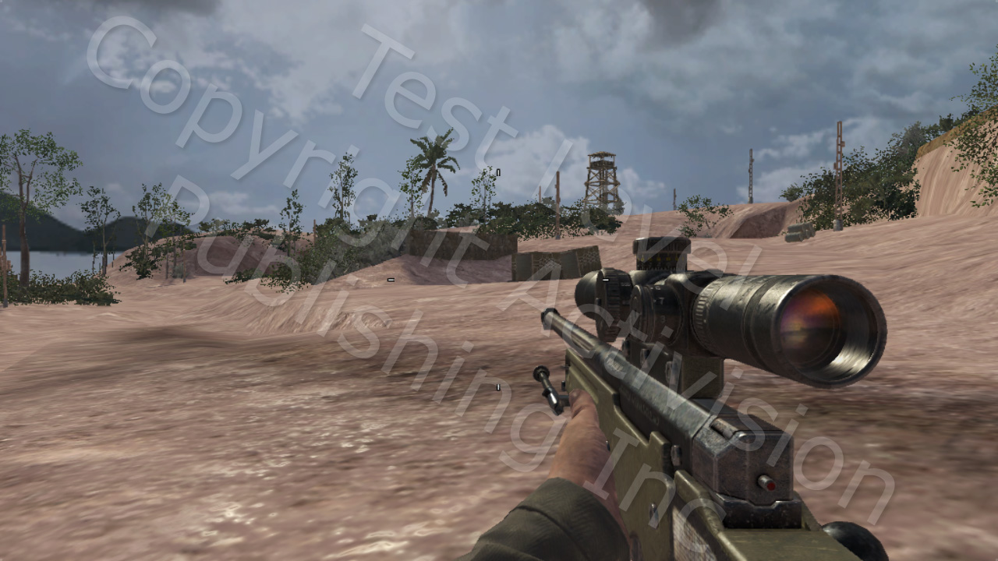
No Fresnel
Notes:
“No Fresnel” uses the base reflectance (which for most materials is quite low) for all angles.

Slide 35
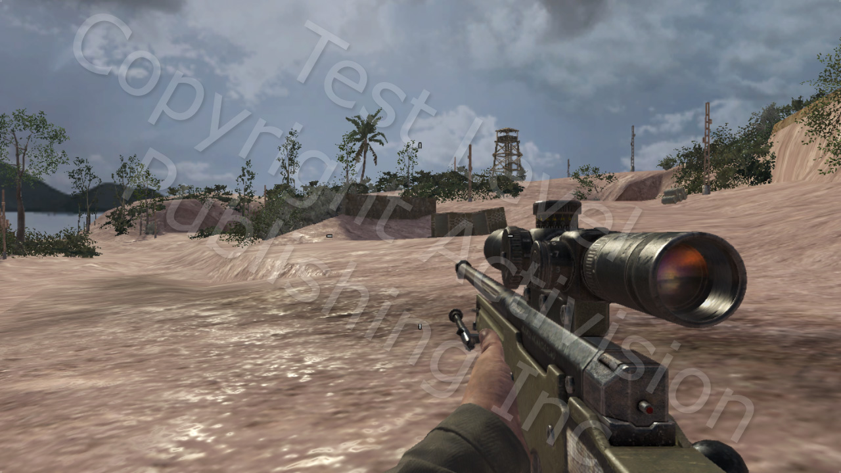
Correct Fresnel
Notes:
This version uses the correct (for highlights) “x=(l dot h)” term for the Shlick approximation.
This is a very specific term – it only kicks in when both the view and lighting directions form large angles with the surface normal. So you can see that it brightens the reflections in a selective manner compared to “no Fresnel”.

Slide 36
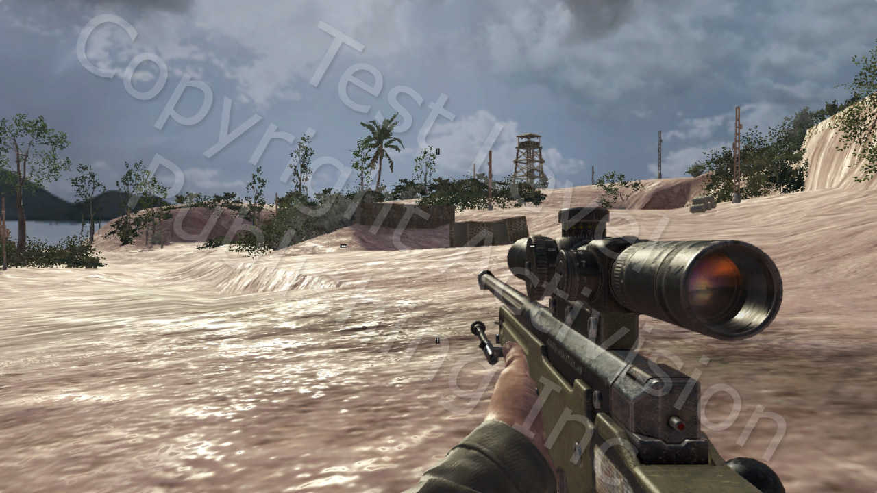
Incorrect Fresnel
Notes:
Here highlight Fresnel uses the “x=(n dot v)” term, which is correct for mirror reflections but incorrect for point light highlights.
This term is too non-specific, and brightens up the highlights all over the scene whenever the surface normal is glancing to the view direction.
“No Fresnel” is actually closer to the correct image.

Slide 37
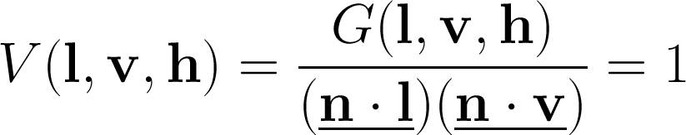
Visibility functions
No visibility function:
Shadowing-masking function is effectively:
Notes:
This is a very common case in game engines.
You can think of this as an implicit “cheaper than free” (because it also avoids the foreshortening terms) shadowing-masking function.

Slide 38
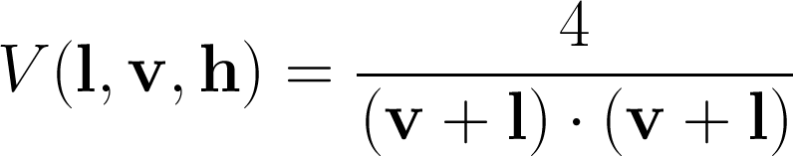
Visibility functions continued
Kelemen-Szirmay-Kalos approximation to Cook-Torrance visibility function:
Notes:
A pretty good approximation to Cook-Torrance shadow-masking function.
Needs clamping to epsilon (or adding epsilon and clamping to zero) to avoid divide by zero.
Emphasis on the un-normalized V/L sum, and un-saturated dot product (i.e. this dot product can exceed one, which is by design).
On DX9 class GPU:
4 instructions

Slide 39
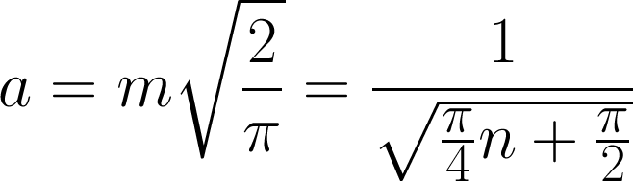
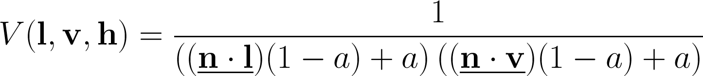
Visibility functions continued
Schlick's approximation to Smith's Shadowing Function
Notes:
Shlick originally defined this in terms of the Beckmann “m” roughness, so we need to convert to the “n” specular power.
On DX9 class GPU:
8 instructions.

Slide 40
Visibility functions comparison
Having no Visibility function makes the specular too dark, but costs nothing
Kelemen-Szirmay-Kalos is too bright and does not account for roughness/gloss, but costs little and is a pretty good approximation to the Cook-Torrence Shadow-Masking function
Schlick-Smith gives excellent results, albeit costs the most
Notes:
We shipped Call of Duty: Black Ops with Smith Visibility function.
Even though more expensive than Kelemen, the savings we made from Beckmann paid off for using the higher quality Smith function.
Beckmann + Kelemen = 11 + 4 = 15
Blinn-Phong + Schlick = 6 + 8 = 14

Slide 41
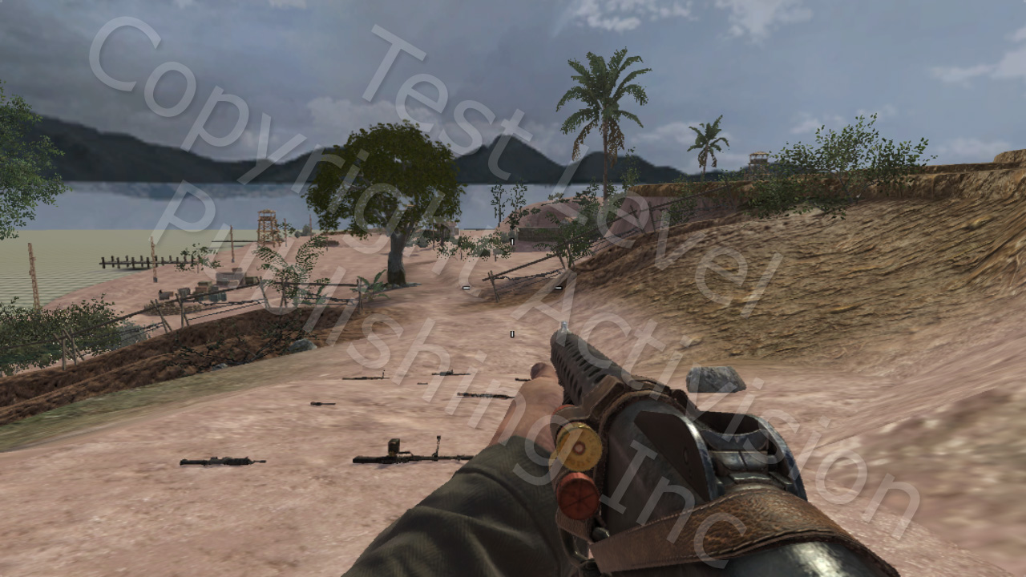
No Visibility function

Slide 42

Schlick-Smith Visibility function

Slide 43
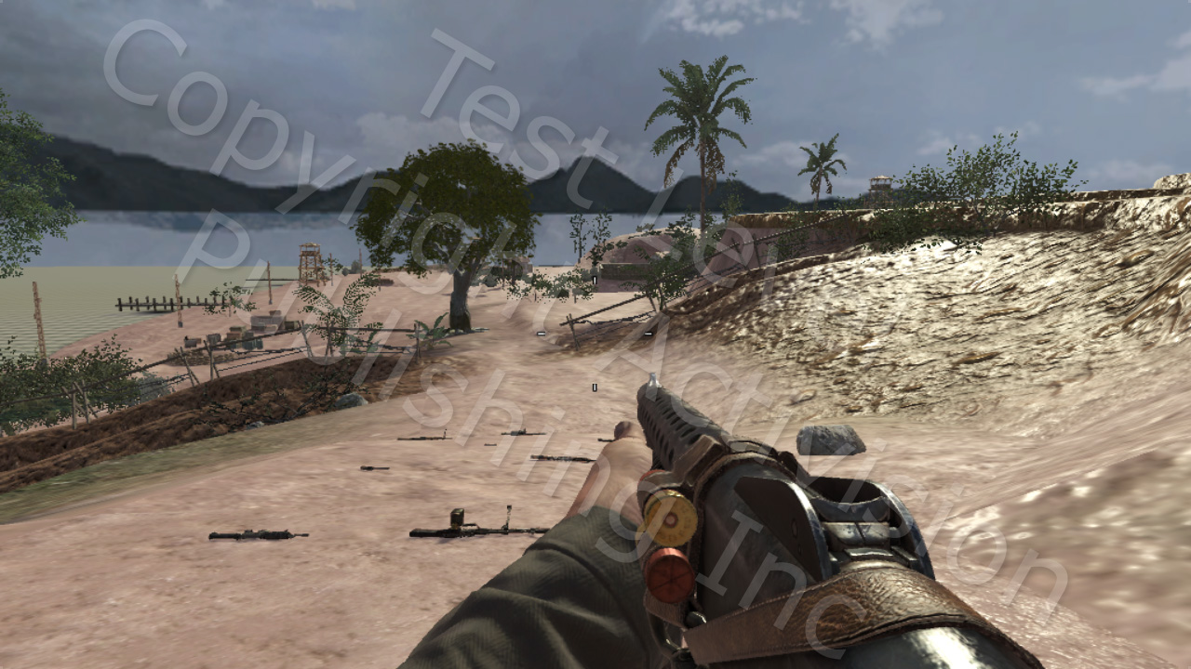
Kelemen Visibility function

Slide 44
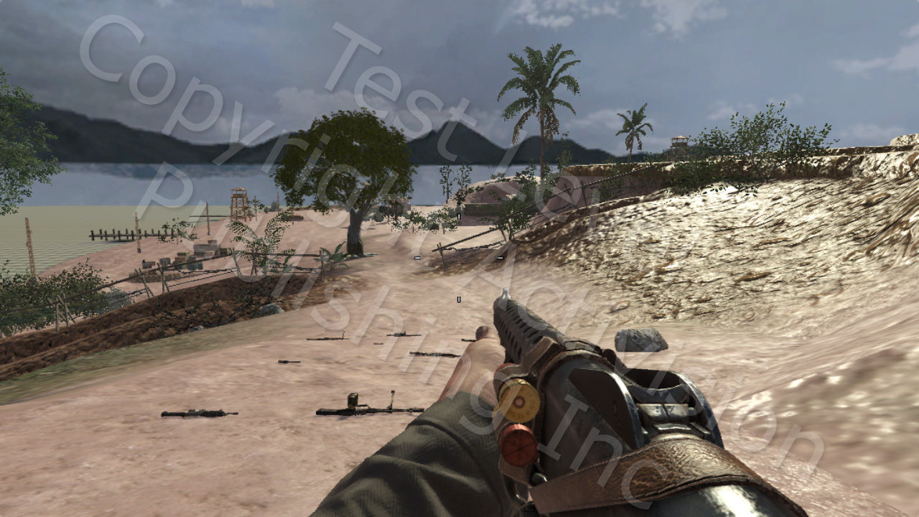
Cook-Torrance Visibility function

Slide 45
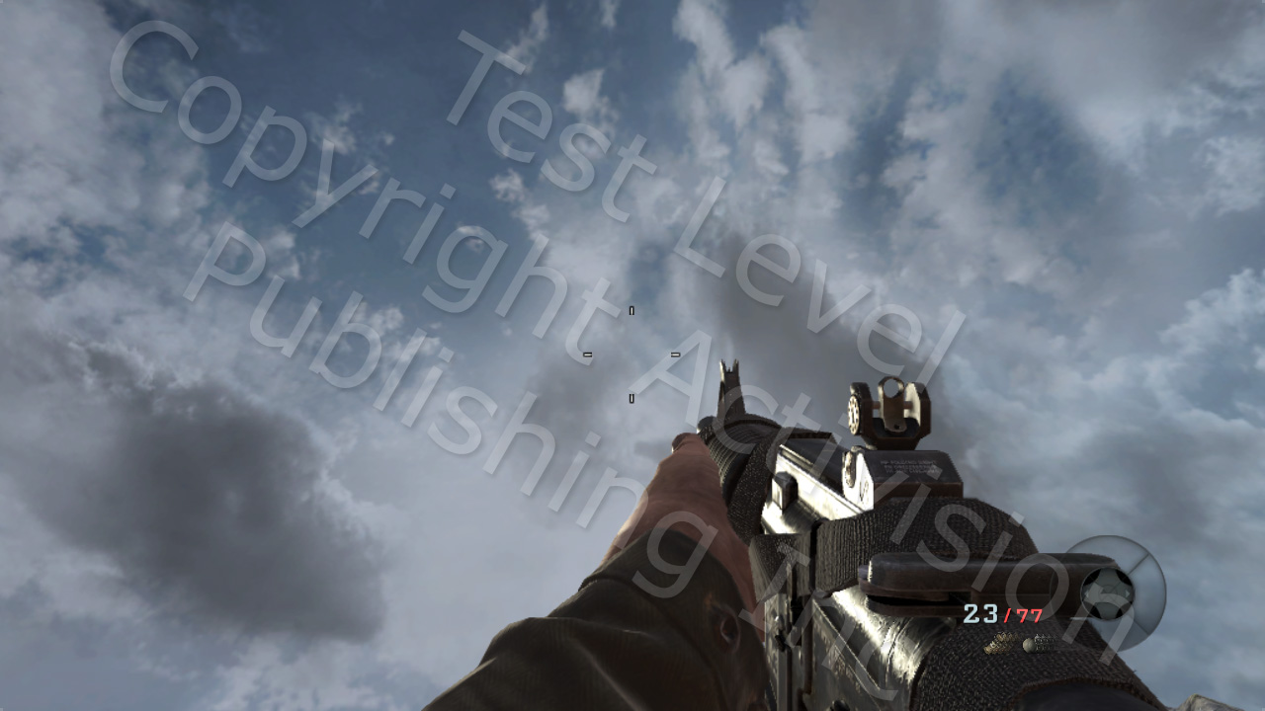
Schlick-Smith Visibility function

Slide 46
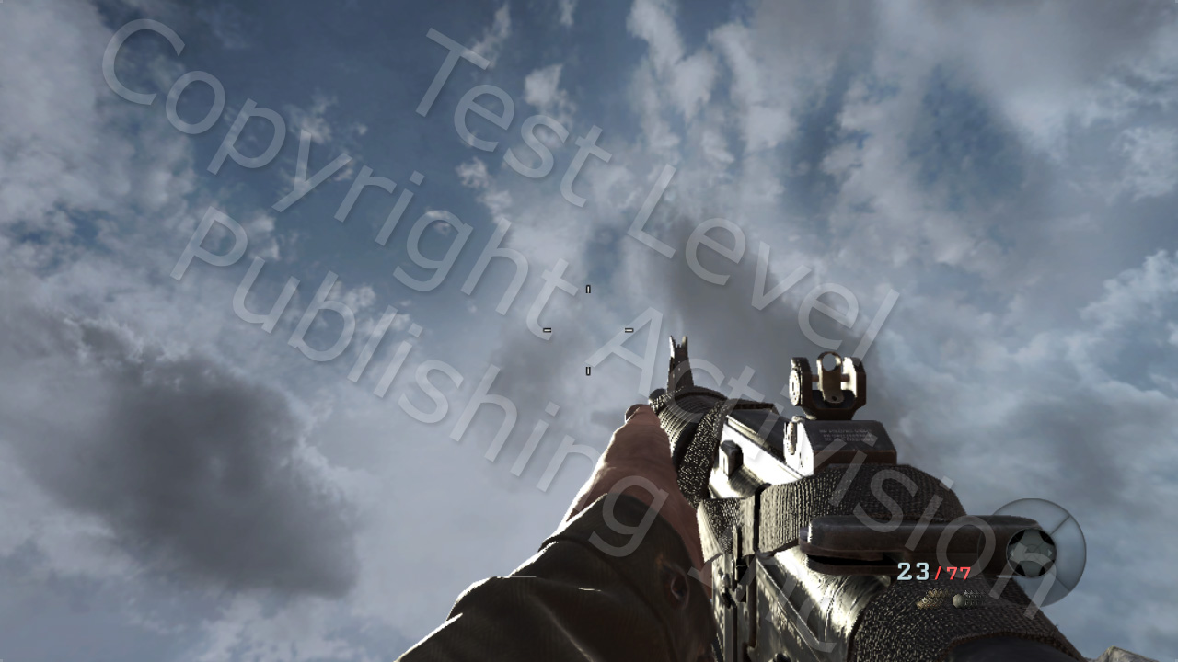
Kelemen Visibility function
Notes:
Notice the problems due to lack of respect for roughness/gloss

Slide 47
Environment maps
Traditionally we had dozens of environment probes to match lighting conditions
Low resolution due to memory constraints
Transition issues, specular pops, continuity on large meshes
For Black Ops we wanted to address these issues and also have higher resolution environment maps to match our high specular power
Notes:
One environment map per surface.
Call of Duty: World at War used dozens of 64x64 environment maps.
Call of Duty: Black Ops switched to 256x256 environment maps, but having dozens of them was prohibitive in memory cost.

Slide 48
Environment maps: normalization
The solution:
Normalize – divide out environment map by average diffuse lighting at the capture point
De-normalize – multiply environment map by average diffuse lighting reconstructed per pixel from lightmap/lightgrid
Notes:
The normalization process turns the environment map into a environment distribution map - it no longer encodes absolute intensities but the distribution of light intensities over the various incoming directions.
The average lighting can be recovered from the already existing information in the lightmap/lightgrid.
The normalization must be performed before filtering / mip mapping.

Slide 49
Environment maps: normalization
The normalization allows environment maps to fit better in different lighting conditions
Outdoor areas can get away with as little as one environment map
Indoor areas need more location specific environment maps to capture secondary specular lighting
Notes:
1 environment map is a bit too extreme.
Normalization will still let you reuse more often than not.

Slide 50
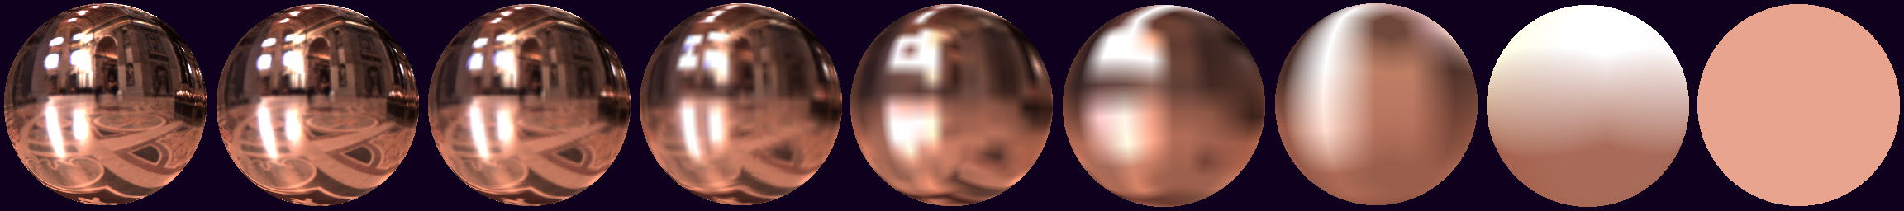
Environment map: prefiltering
Mipmaps are prefiltered and generated with AMD/ATI’s CubeMapGen
HDR angular extent filtering
Face edges fixup
Notes:
Support for CubeMapGen is unfortunately discontinued.
DXT face stitching still a problem – fundamentally it is very hard to satisfy both correct color and edge conditions at the same time.
50

Slide 51
Environment maps: blurring
The mip is selected based on the material gloss
texCUBElod( uv, float4( R, nMips - gloss * nMips ) )
For very glossy surfaces this could cause texture trashing
Some GPUs have an instruction to get the hardware selected mip
Notes:
R is the reflection vector of V around N.
We used 256x256 environment maps – number of mips = 8.
Since gloss is dependent on specular power, we (empirically) chose a specular power that matches the blurriness of a 256x256 environment map
The texture trashing was minimized by a different method (variance-to-gloss).

Slide 52
Environment maps: Fresnel
Fresnel is based on the angle between the view/light vector and the surface normal
Mirror reflections: surface normal well defined (n)
Microfacet highlights: surface normal well defined (h)
Glossy reflections: average over many different microfacet normals – which Fresnel to use?
Notes:
There is not a single well-defined surface normal

Slide 53
Fresnel for glossy reflections
A full solution would involve multiple samples from the environment map and BRDF together
We can’t do that, so we fit a cheap curve to the integral of the BRDF over the hemisphere
Multiply it by the value read from the prefiltered cube map
Isn’t only Fresnel, also has the shadowing/masking term

Slide 54
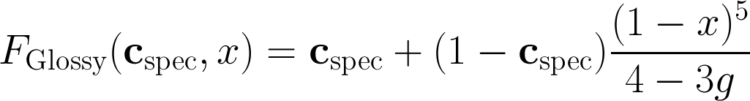
Fresnel for glossy reflections
Environment map “Fresnel”
In this case x = (n•v)
Notes:
This factor needs more tuning, the current approximation is a bit too bright, especially for rough surfaces (recall that “g” is the gloss value read from the gloss map texture).

Slide 55
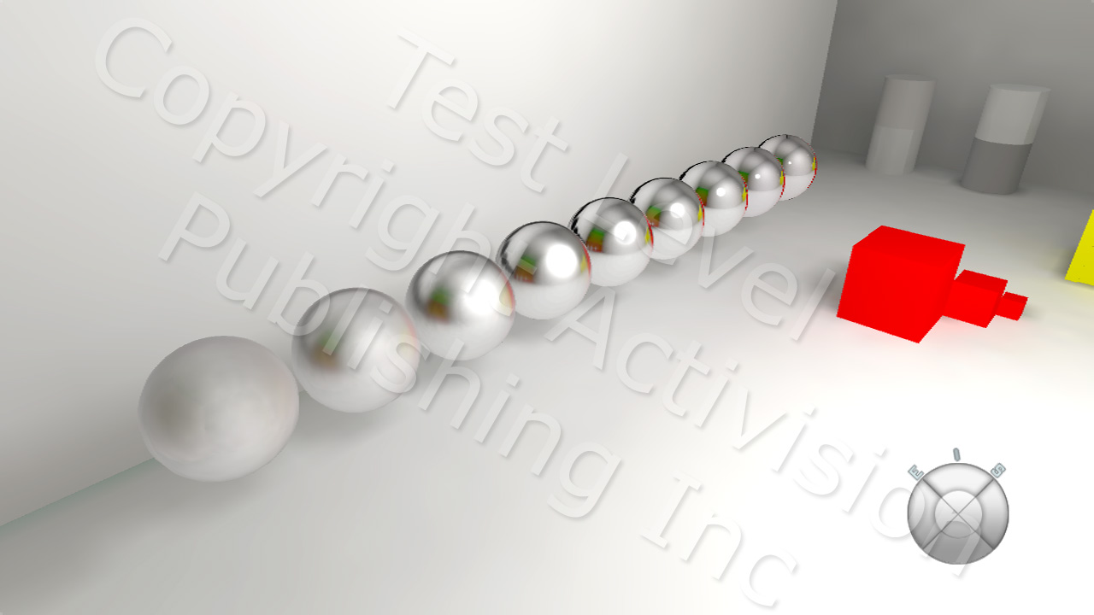
Environment maps continued
Notes:
Notice how environment map blurring matches the hot spot roll-off.

Slide 56
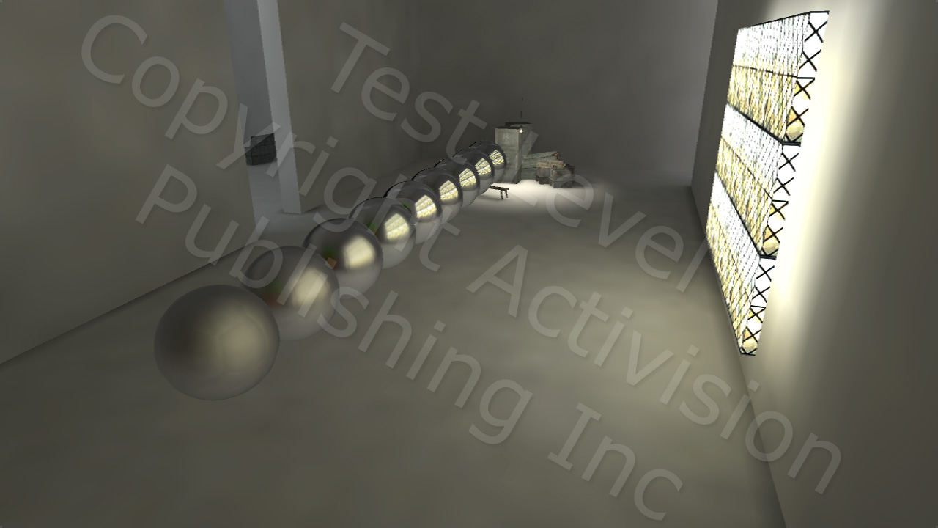
Environment maps continued
Notes:
The pre-filtering works well with just secondary lighting too.

Slide 57
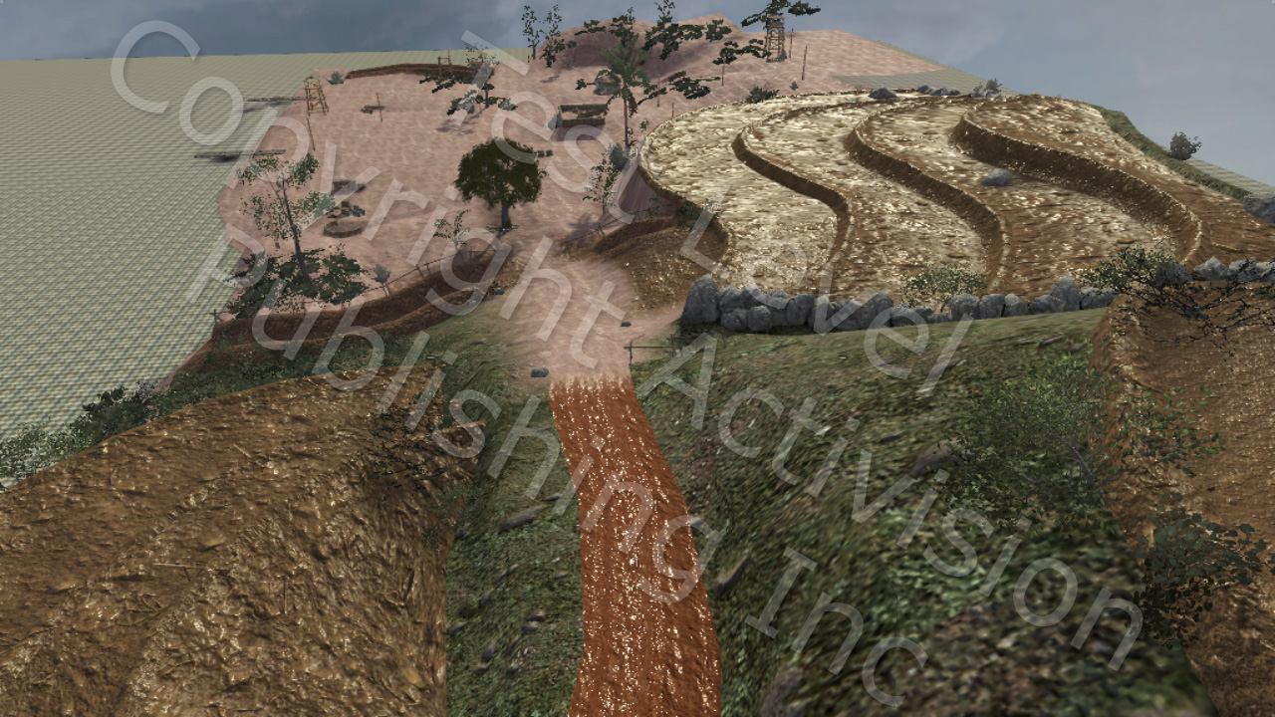
Too much specular …
Notes:
In all of the previous images, there was some additional magic that made them look good.
Here’s what it looks like without that magic.

Slide 58
Too much specular …
Initial suspects:
Fresnel can boost up the material specular color for both the procedural light and the environment map
Any non trivial Visibility function can also amplify the specular color at certain angles
Notes:
Knee-jerk reaction is to kill Fresnel and Shadow-Masking functions.

Slide 59
Too much specular …
The real culprit:
Normal map mipping will make large distant surfaces behave like giant mirrors

Slide 60
Normal Variance
Variance maps can directly encode the lost information from mipping normal maps (see also “LEAN Mapping” from I3D 2010)
Variance maps need high precision and cost extra to store, read and decode in the shader
What if we combine them with the gloss maps offline?
Notes:
See Marc Olano & Dan Baker’s LEAN mapping paper from I3d 2010 and Dan Baker’s CLEAN mapping paper from GDC 2011.

Slide 61
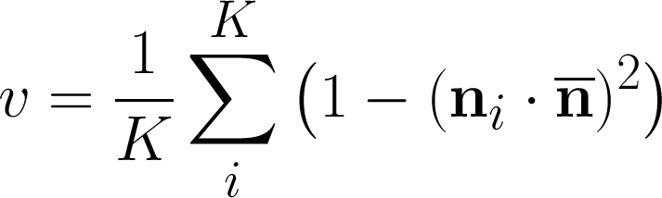
Normal Variance continued
Extract projected variance from the normal map, always from the top mip, preferably with a NxN weighted filter:
Notes:
We used a 3x3 tent shaped filter to model the variance coming from bilinear filtering.
“v” is the variance.
‘n overbar’ is the local average normal (within the filter range)
The “one minus dot squared” quantity is the “sine” of the angle between each normal and the local average. This is a measure of variance, however this is not the exact variance of the Beckmann distribution, which is a “tangent” of the angle.

Slide 62
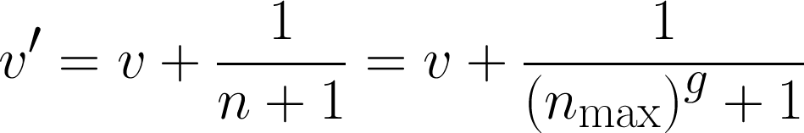
Normal Variance continued
Add in the authored gloss, converted to variance:
Notes:
Once we have the normal variance we add in the variance from the gloss map. Recall that “n” (the specular power) is equal to “n_max” (the max specular power, 8192 for Black Ops) raised to the power of the value “g” read from the gloss map.

Slide 63
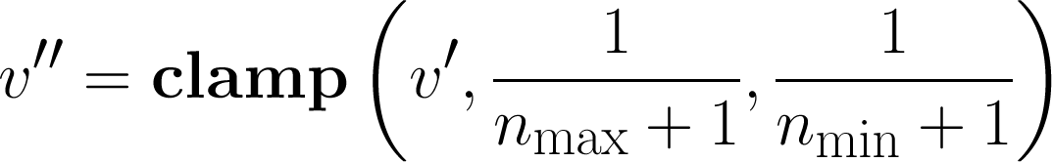
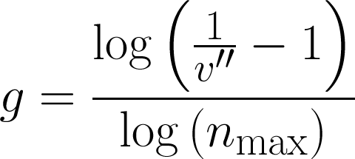
Normal Variance continued
Convert variance back to gloss:
Notes:
Min specular power = 1
Max specular power = 8192

Slide 64
Normal Variance continued
This method solved the majority of our specular intensity issues
Tends to anti-alias the specular as well
Minimizes the chance for texture trashing when gloss-controlling the mips of the environment map
Notes:
Normals and Gloss need to be known at convert time.
Does not help with vertex normal variance.

Slide 65
Without Variance-to-Gloss
Notes:
All surfaces have the non-metal specular color of 0.04.

Slide 66
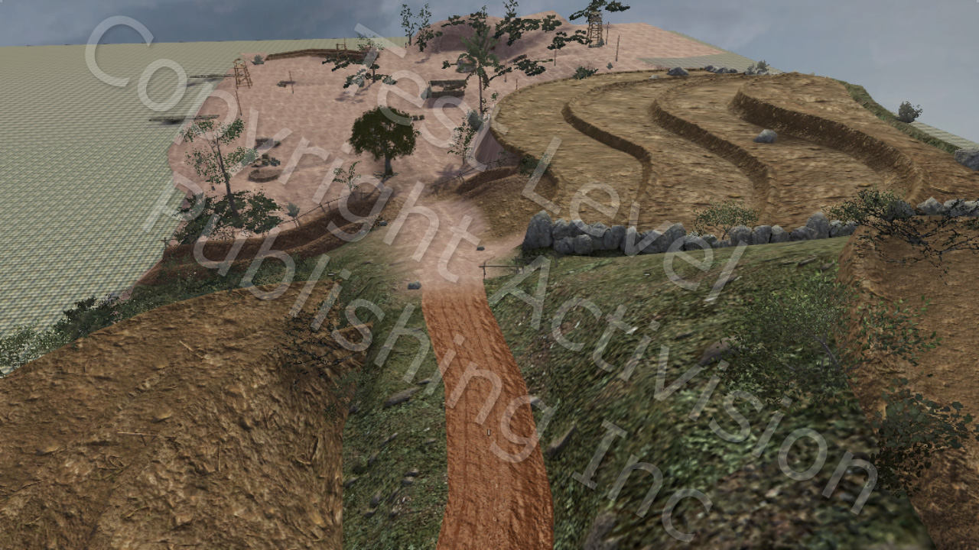
With Variance-to-Gloss

Slide 67
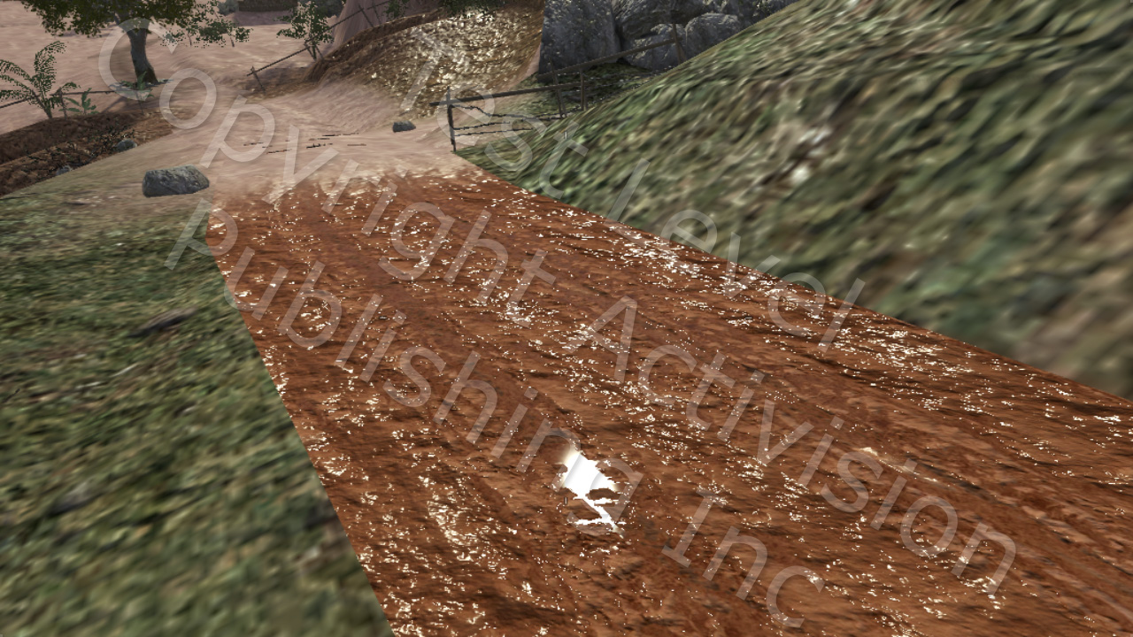
Without Variance-to-Gloss
Notes:
Very high gloss on the “tracks”.

Slide 68
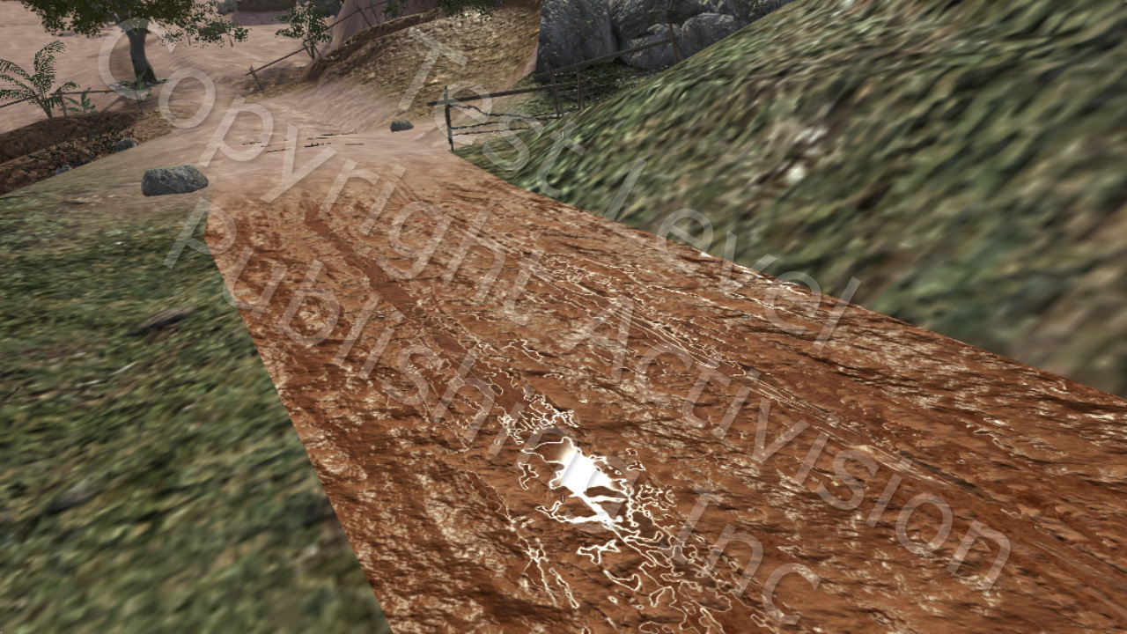
With Variance-to-Gloss
Notes:
Notice the “edging” caused by the 3x3 filter performed on the top mip.

Slide 69
The Art perspective
Even with all techniques properly implemented the “ease of authoring” still elusive
Artists had trouble adjusting to the new concepts and the slight loss of (specular) control
Education and good examples are essential
Pre-existing notions and workflow need to be re-examined

Slide 70
Diffuse textures
Using amateur photos as diffuse maps no longer works well
Diffuse textures can and should be carefully calibrated (can be directly captured through cross polarization)
It takes more effort but it pays off later when lighting “just works”
Notes:
Photos are composite images of both diffuse and specular.
Gamma correction makes things trickier, especially if not using calibrated monitors/TVs.
Cross-polarization-separated-diffuse can surprise even veteran/technical artists.

Slide 71
Specular textures
Specular maps no longer control the maximum specular effect
Ambient occlusion maps can control it but they have to be used judiciously
Specular maps less important than gloss maps
Notes:
Can’t bake AO into the specular anymore.

Slide 72
Gloss textures
Perhaps the most important yet most difficult maps to author
It takes time to build an intuition on how to paint them. WYSIWYG tools can help tremendously
It might be possible to directly capture from real surfaces
Notes:
Would be nice to have support for gloss maps in Z-Brush, Mudbox and other 3D painting packages

Slide 73
Special cases
With Physically Based Shading, material specular color can be roughly separated in two groups:
Metals – colored specular above 0.5 linear space
Non-metals – monochrome specular between 0.02 and 0.04 linear space
What if we create a material/shader that takes advantage of this?
Notes:
With PBS specular color is also known as base reflectance -> easy to measure.

Slide 74
Special cases continued
Pure metal shader
No diffuse texture and no diffuse lighting
“Simple” shader (non-metals)
No specular texture (hardcoded to 0.03 in shader)
Specular lighting calculations can be scalar instead of vector
Notes:
“metalness” shader is a bad idea (see bonus slides).
We didn’t actually use the Pure Metal shader because it’s a relatively rare case.
The “simple” shader was actually a huge hit. In the context of Black Ops there are a tons of materials that can be modeled with it – dirt, rocks, wood, cloth etc.

Slide 75
Performance
Physically Based Shading is relatively more expensive (average 10-20% more ALU)
Using special case shaders helps
For texture bound shaders the extra ALU cost can be hidden
Still a good idea to have a fast Lambert shader for select cases
Notes:
Cost increase as compared to Call of Duty: World at War.
It would be more if compared to bare-bones Phong.
Lambert: everything in nature has specular, however for certain cases it might not be reasonable to pay the specular cost (foliage, fences etc).

Slide 76
Conclusions
Physically Based Shading is totally worth it! It will make your specular truly “next gen”
Be prepared to put a decent amount of effort on both the Engineering and Art side to get the benefits
It is a package deal – difficult or impossible to skip certain parts of the implementation
Don’t go overboard
Notes:
Package deal:
Can use just the Blinn-Phong normalization term
Can use default Visibility function
Fresnel will force the issue of good Visibility function and normal mipping (variance)

Slide 77
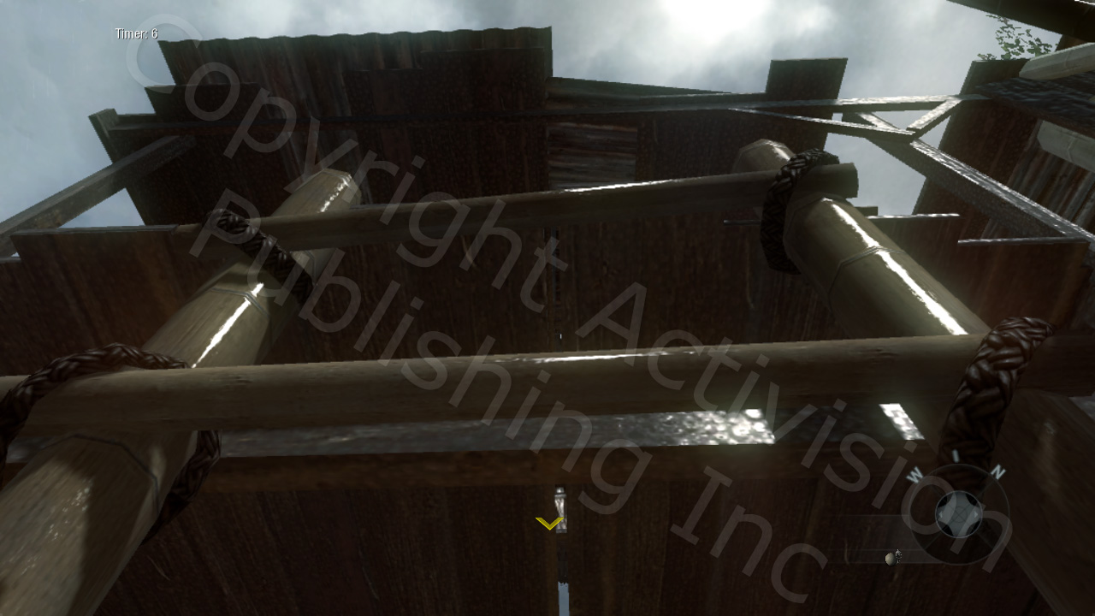
Conclusions

Slide 78
Thanks
Natalya Tatarchuk
Naty Hoffman
Paul Edelstein
The Call of Duty: Black Ops Team

Slide 79
Contact info
Email me at dlazarov@treyarch.com

Slide 80
Bonus slides

Slide 81
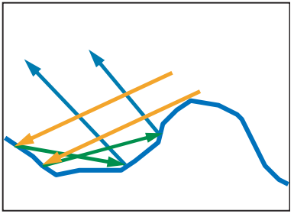
Multiple surface bounces
In reality, blocked light continues to bounce; some will eventually contribute to the BRDF
Microfacet BRDFs ignore this – assume all blocked light is lost
Image from “Real-Time Rendering, 3rd Edition”, A K Peters 2008
Notes:
This assumption is one of the ways in which microfacet theory is only an approximation; in a sense it is similar to the assumption behind ambient occlusion (that directions blocked by other geometry contribute no light).
81

Slide 82
Blinn-Phong normalization
Some games use (n+8) instead of (n+2)
The (n+8) “Hoffman-Sloan” normalization factor first appeared in “Real-Time Rendering, 3rd edition”
Result of normalizing entire BRDF rather than just NDF
Compensates for overly dark visibility function
More accurate to use (n+2) with better visibility function
Notes:
“Real-Time Rendering” 3rd edition did also discuss the (n+2) factor, but it recommended (n+8). The (n+8) results from normalizing the entire BRDF. The BRDF used had a too-dark visibility function (the implicit one described separately in the talk) so the normalization factor ends up being brighter to compensate. The problem is that this brightening happens at the wrong angles – it is more correct to normalize just the NDF by itself (resulting in n+2) and then to use a brighter visibility term. Visibility terms are discussed in more detail in other slides.
82

Slide 83
Ambient Occlusion
Materials with AO maps can suppress secondary diffuse, primary and secondary specular
Suppressing primary specular is not entirely correct yet not entirely wrong if we consider AO as microfacet self-shadowing
AO will mip to below white and compensate (somewhat) against the normal map mipping
Notes:
AO is great, but it’s meant to be subtle, so it can’t solve the normal mipping problem on its own.

Slide 84
Primary lighting selection
Static world surfaces (BSP) are split offline to resolve primary lighting conflicts
Static objects pick a primary based on their (adjustable) lighting origin
Dynamic objects pick a primary every time they move
Other lighting (direct from secondary light sources and indirect bounce from primary & secondary) is baked
Notes:
When authoring primary lights, lighters are vary careful to avoid overlaps.
Desired overlaps can still be handled by using secondary lights (either manually or by demoting via special separation planes).

Slide 85
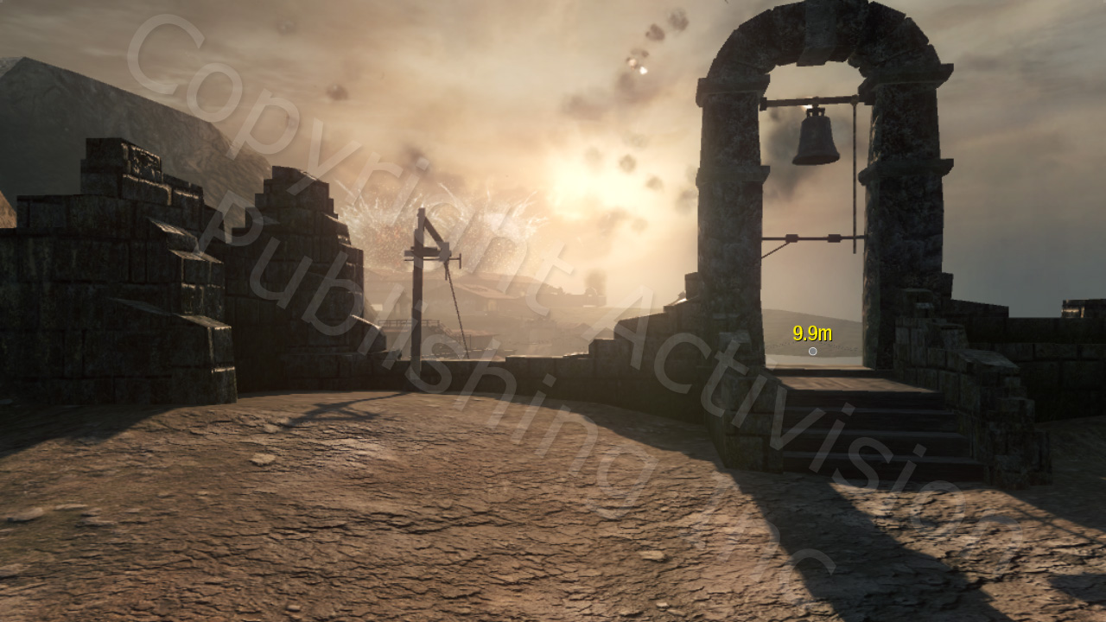
BSP
Notes:
BSP is authored via a dedicated editor (Radiant)
Certain (tagged) static objects can be baked as BSP.

Slide 86
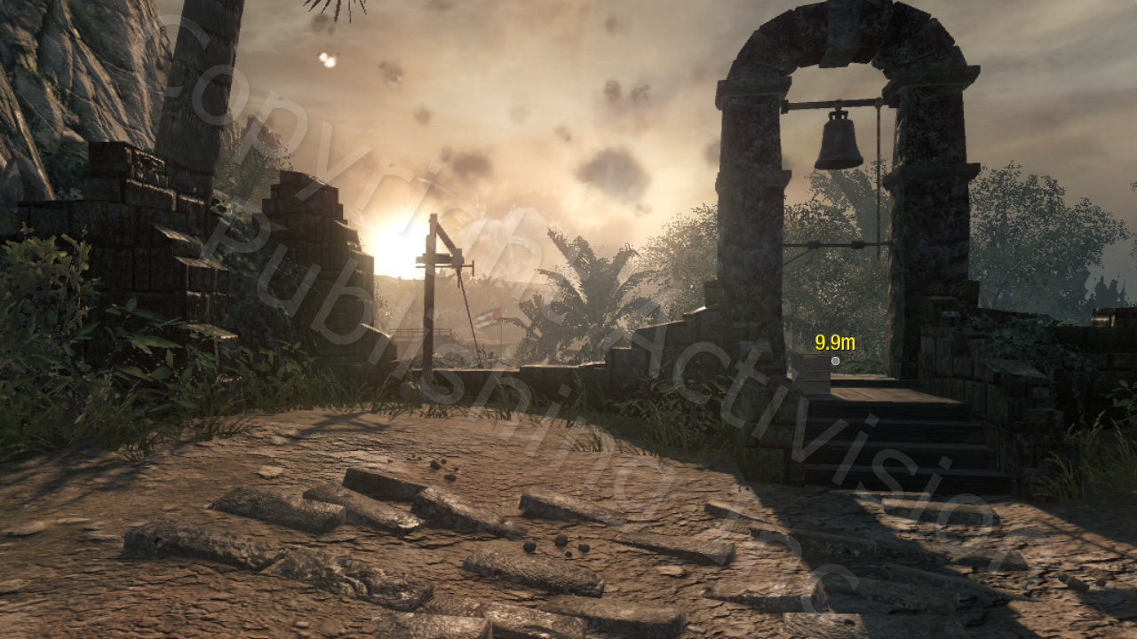
BSP + static objects

Slide 87
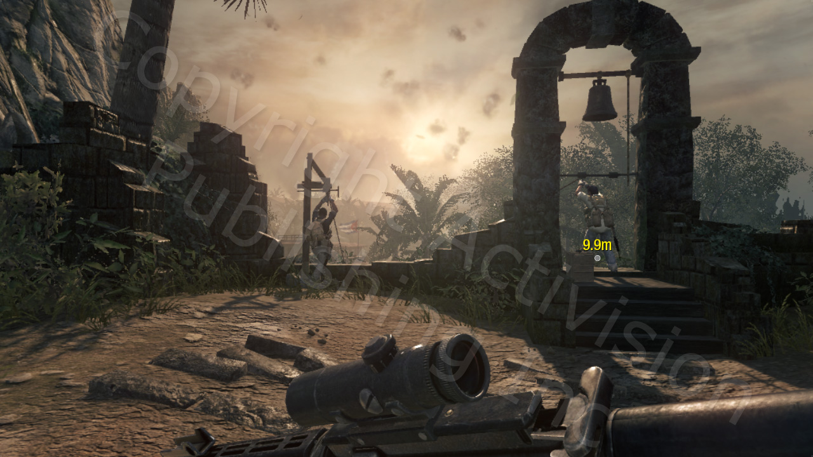
BSP + static and dynamic objects

Slide 88
Metalness method
Two textures: color and metalness
If metalness is 1 then color is treated as specular color and diffuse color is assumed to be black
If metalness is 0 then color is treated as diffuse color and specular color is assumed to be 0.03 linear
This works for non binary values of metalness as well

Slide 89
Metalness method continued
Great idea, but it doesn’t work well in practice
Artists will have hard time figuring out the concept
The resulting shader will actually be more expensive than a traditional shader
There is no storage advantage when textures are DXT compressed
No advantage when using forward rendering either
Notes:
Bottom line – don’t do it.

